Slide 1
Online Grocery Shopping
Presented by:
Santoshi Pawar(1066)
Priyanka Thube(1100)
Mr.Prashant Karhale Mr.KAshinath Patil
Course Coordinator Project Guide

Slide 2
Content
Introduction
Motivation
Objectives
Application
Advantage and Disadvantage
Screenshot
Conclusion
References

Slide 3
Introduction
Internet technology involes not only in traditional industry,but also in e-commerce,online shopping is remarkable case.
Online shopping will not be restricted by time and region,so it convient to understand the information of all commodities,
This development model has promoted the economic development greatly. At the same time, the emergence of trading platform such as mobile payment, online payment, these kinds of payment methods are convenient and quick.

Slide 4
Motivation
Due to the pandemic, many people lost their business or shops.
So to make a platform available to the ordinary seller across different areas to sell their product we have developed this web application.
Customer can buy grocery product from sellers without travelling.

Slide 5
Objectives
This system provides customer category wise products at their place.
Any ordinary shop owner can sell their products.
Vendors can add products and edit price, quantity and can delete products.

Slide 6
Application
This system will be implemented as a web application. We have created an Online Grocery Shop website where a catalog of products will be displayed .
As any other Online Grocery Shop website, this system will give many options to the user to buy or just view a product.

Slide 7
Advantages & Disadvantages
Advantages:
Can shop for 24*7.
It is more User-Friendly.
It is more time saving
Better service.
Regular monthly discount is available.
Disadvantages:
Not able to touch or try.
Actual product may differ.
Availability of internet is must.

Slide 8
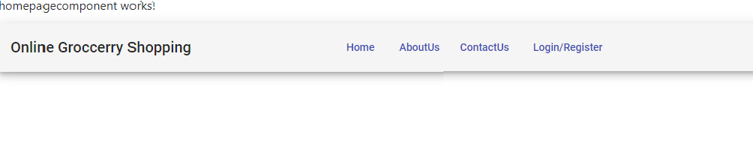
ScreenShots:HomePage

Slide 9
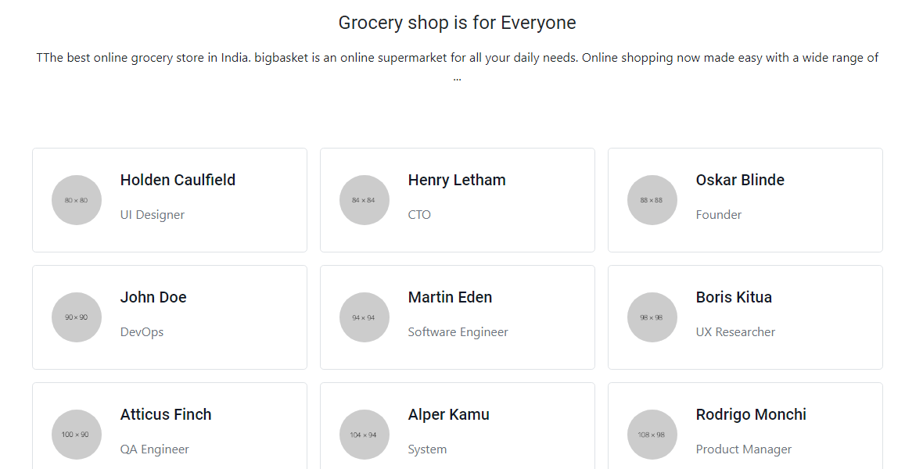
ScreenShots:ABout Us

Slide 10
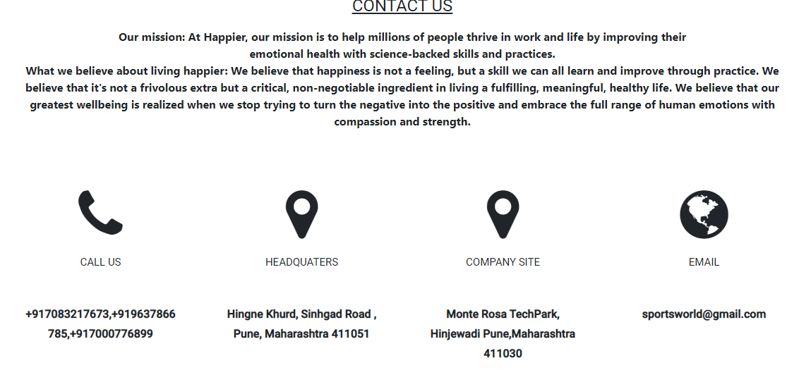
ScreenShots:Contact Us

Slide 11
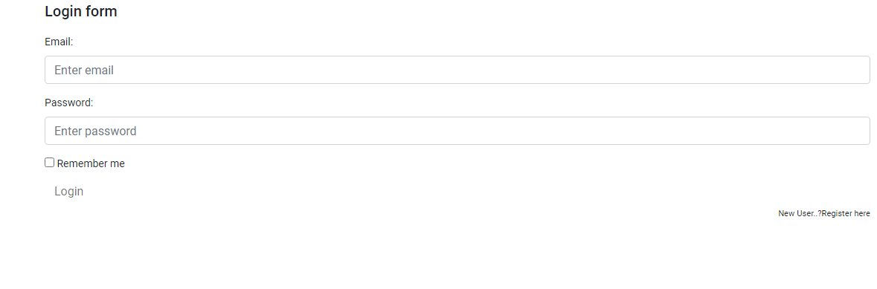
ScreenShots:Login/Register

Slide 12
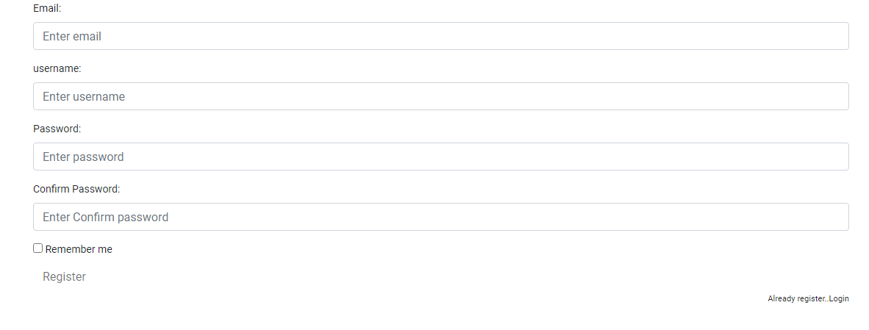
ScreenShots:Login/Register

Slide 13
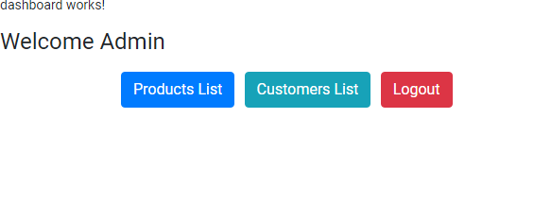
ScreenShots:Admin Page

Slide 14
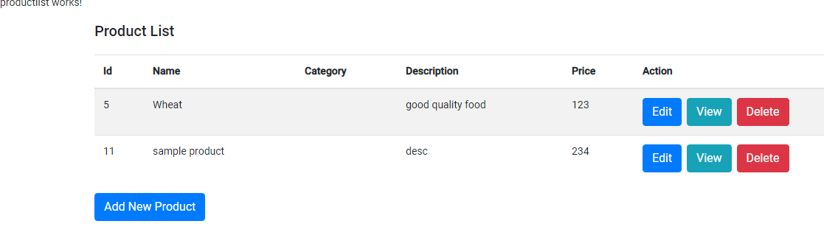
ScreenShots:Product List

Slide 15
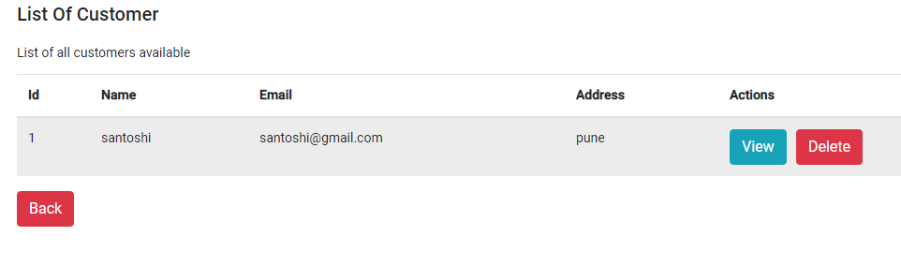
ScreenShots:Customer List

Slide 16
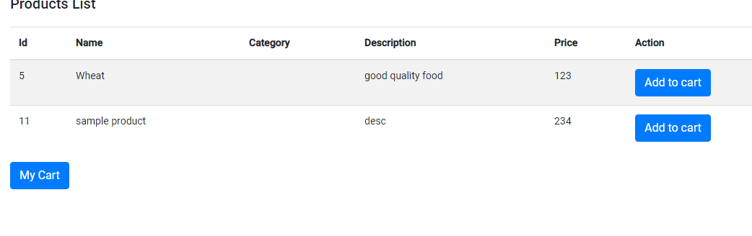
ScreenShots:Customer Page

Slide 17
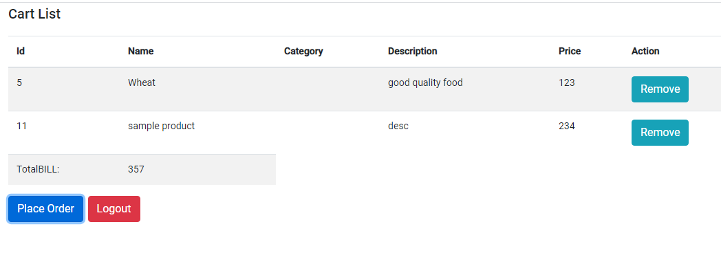
ScreenShots:MyCart

Slide 18
Conclusion
It is user friendly application and promotes user to purchase or shop faster.
Being able to buy anytime anywhere.
Availability of platform to the any seller.
Home delivery you don’t have to travel to shop.

Slide 19
References
Java By Budo Timothy “Understanding Object- Oriented Programming with JAVA” . Pearson,1999
Java By Balgurusamy E “ Programming with JAVA, A Primer” Tata Mcgraw Hill,2006.

Slide 20
THANK-YOU

